Slide 1
Week 3 Presentation

Slide 2
Literature by Sheffield dynamics group only tangentially relevant
Often related to time data instead of frequency

Slide 3
Method 1: CNN Approach
Based on “Deep Learning for the Precise Peak Detection in High-Resolution LC–MS Data” and “Fake metabolomics chromatogram generation for facilitating deep learning of peak-picking neural networks”
Treat peak detection as semantic segmentation problem (label associated with every element of time series data)
Use U-Net style architecture (but with fewer parameters due to more simplistic problem compared to image segmentation)
Training size approx. 60,000

Slide 4
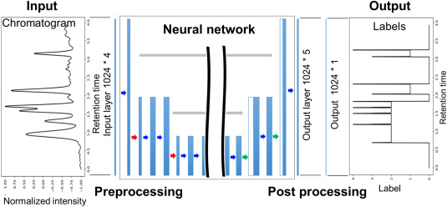
Input includes original data, first and second derivatives, and log values
Trained with 5 labels (no peak, single peak, overlapping peak, start point, end point). Other approach simply classified peak or no peak.
U-Net: downsample to extract features, upsample to retain spacial information, skip connections to avoid information loss

Slide 5
Method 2: Bidirectional RNN
“Enhanced peak picking for onset detection with recurrent neural networks"
Both approaches need fixed length input – potentially normalise between 0 and 1
Can stack multiple RNN layers to add model complexity
RNN vs LSTM: LSTM solves issues of vanishing/ exploding gradients
Output probability of peak or no peak, define a peak when a certain number of outputs in a row are above a certain probability threshold
Can make this threshold low for wider priors

Slide 6
Method 3 ?
Automatic prior detection ?

